Slide 1
SOLID Principles
Nadia Comanici

Slide 2
Demystifying the Acronym
S
O
L
I
D
Single Responsability Principle
Open-Closed Principle
Liskov's
Principle
Interface Segregation
Principle
Dependency Injection
Principle

Slide 3
Single Responsability PrinciplE

Slide 4



How many responsabilities for an object?

Slide 5
Single Responsability Principle
Every object should have a single responsability and that responsability should be entirely encapsulated by the class
There should never be more than one reason for a class to change
(Robert C. Martin – Uncle Bob)

Slide 6
Cohesion & COUPLING
Cohesion
Coupling
- The degree to which a part of a code base forms a logically single, atomic unit
High cohesion = keeping parts of a code base that are related to each other in a single place.
- The degree to which a single unit is independent from others
Low coupling = separating unrelated parts of the code base as much as possible

Slide 7
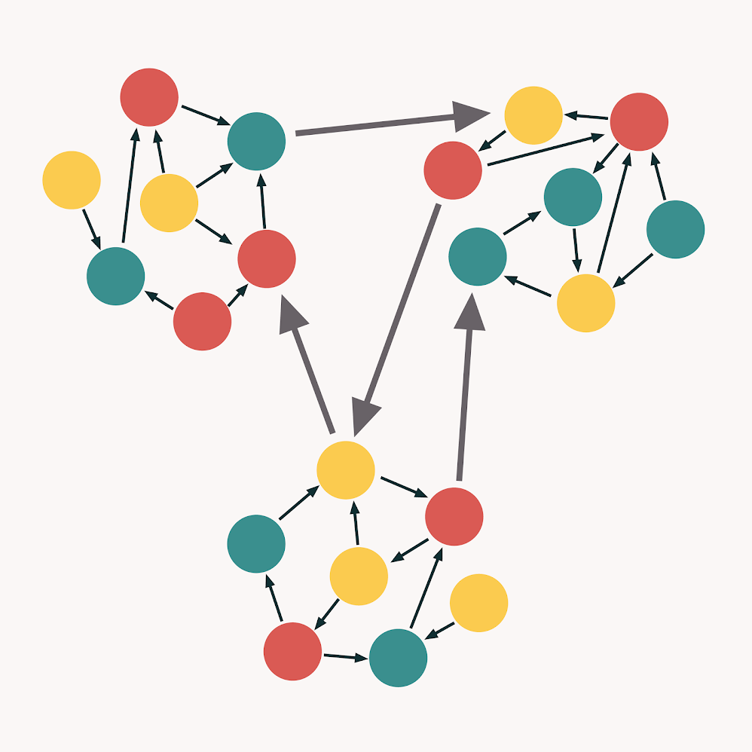
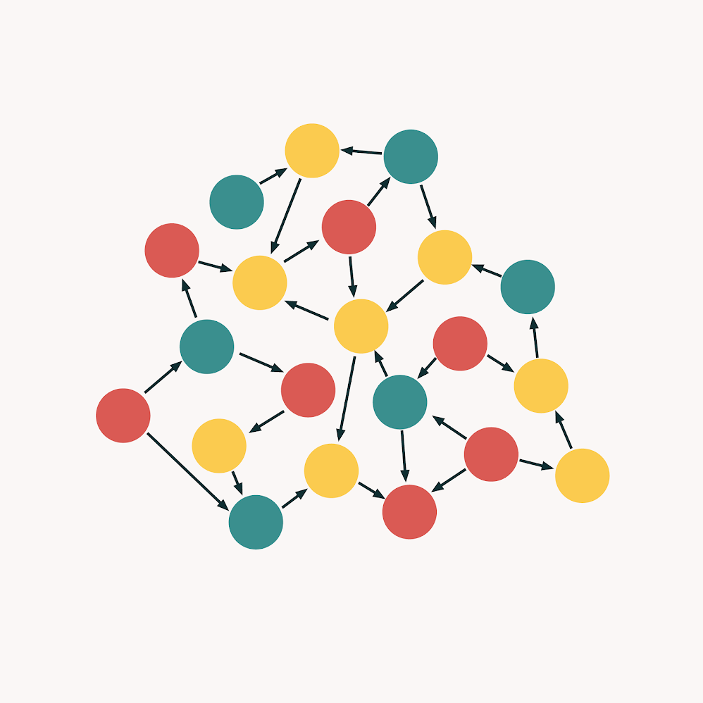
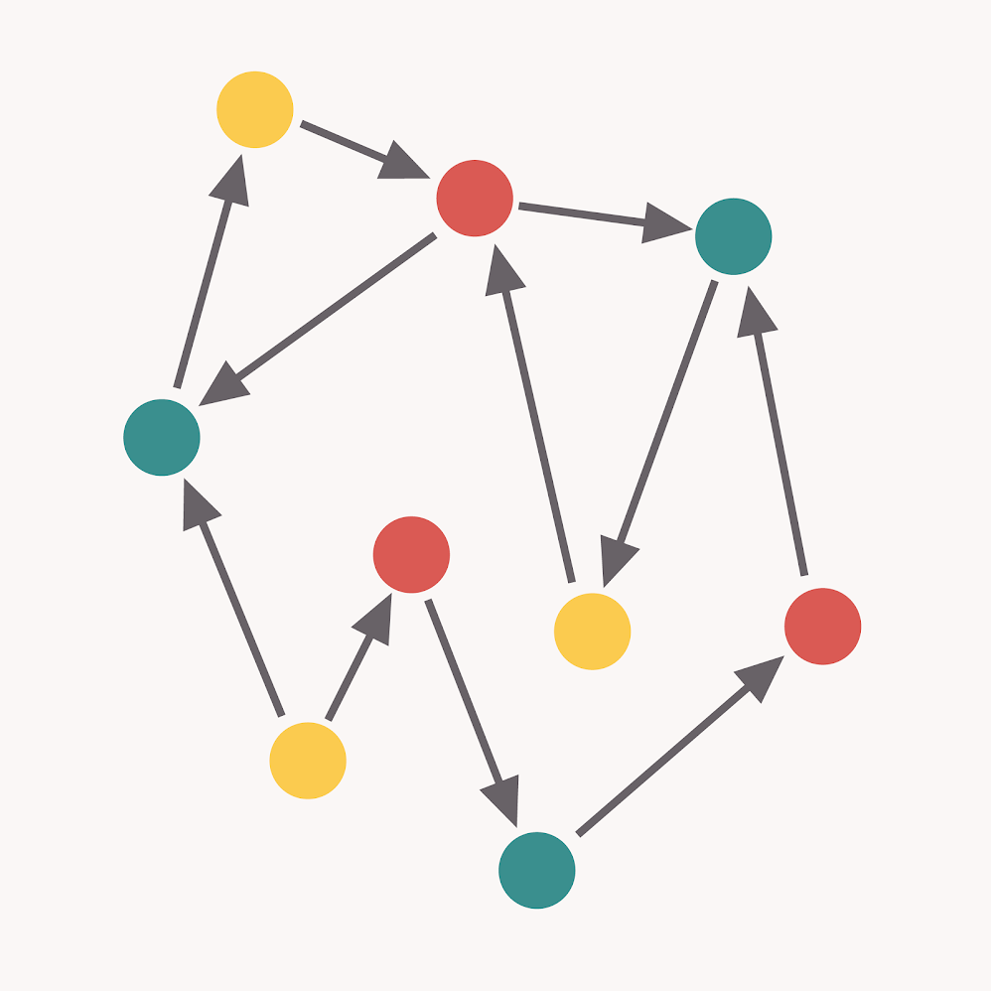
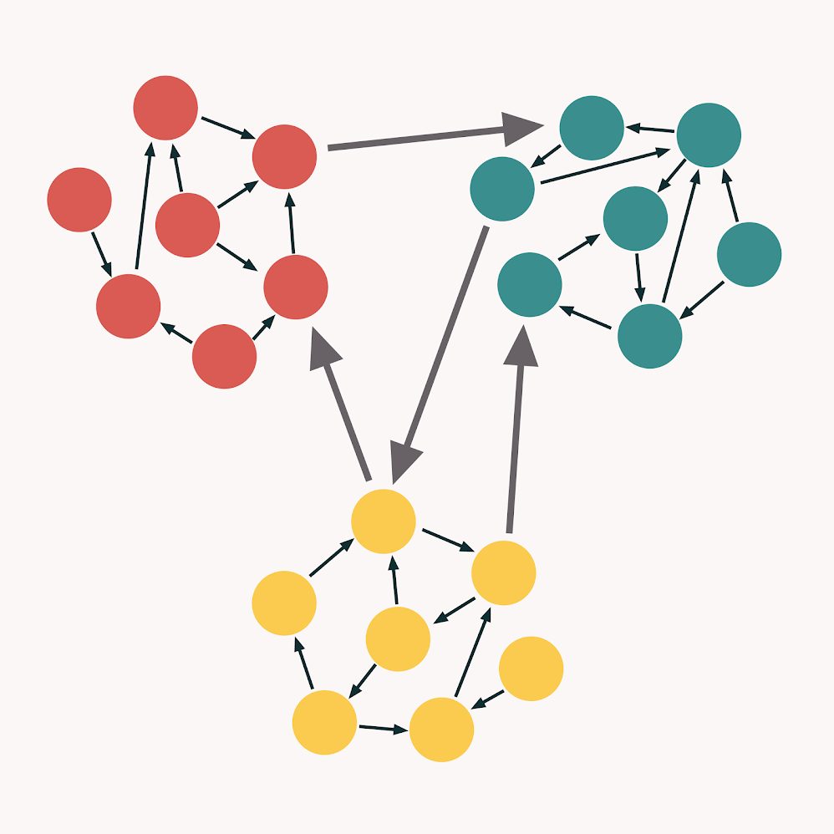
COHESION & COUPLING
Pooly selected boundaries
High Coupling
God Object
Low Coupling
Destructive
Decoupling
Ideal
Low Cohesion
High Cohesion
Source: https://enterprisecraftsmanship.com/2015/09/02/cohesion-coupling-difference/

Slide 8
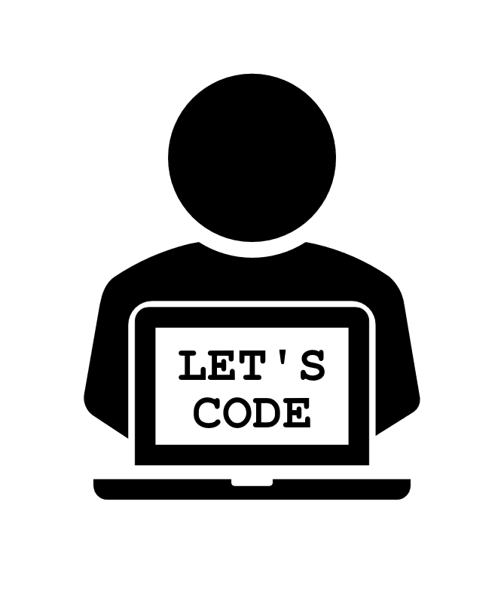
Students Sample
Single Responsibility Principle

Slide 9
How many Responsabilities for University?
Manages admitted student list
University
Writes to disk
Reads from disk
Computes statistics

Slide 10
Orders Sample
Single Responsibility Principle

Slide 11
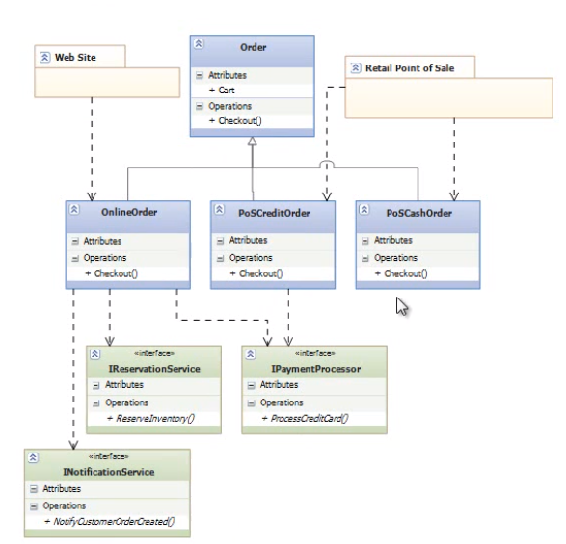
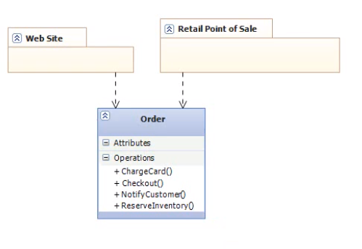
ORDERS SAMPLE

Slide 12
DEPENDENCY INJECTION PRINCIPLE

Slide 13
DEPENDENCY INJECTION PRINCIPLE
High level modules should not depend on low level modules. Both should depend on abstractions
Abstractions should not depend on details. Details should depend on abstractions
(Agile Principles, Patterns and Practices in C#)

Slide 14
What are dependencies?
Framework
Third Party Libraries
Database
File System
Email
Web Services
System Resources (DateTime.Now)
Configuration
The new keyword
Static methods
Thread.Sleep
Random

Slide 15
Class Dependencies
- Class constructors should require all the dependencies that the class needs
Explicit dependencies (clear dependencies in constructor)
Implicit dependencies (hidden dependencies in constructor)

Slide 16
Datetime Sample
Dependency Injection Principle

Slide 17
How do we inject dependencies?
Constructor Injection
Property (Setter) Injection
Parameter Injection

Slide 18
Constructor Injection
Stretegy Pattern
Pros:
Classes are always in a valid state once constructed
Works well with or without container
Cons:
Constructor my have a lot of dependencies
You may need a paramterless constructor (Serialization)
Some methods may not need all dependencies
Dependencies cannot change during the object lifetime

Slide 19
Property (Setter) Injection
Pros:
Dependencies can change during the lifetime of the object
Flexible
Cons:
Objects may be in invalid state after construction
You don’t know all the dependencies and the order in which they should be set

Slide 20
Parameter Injection
Pros:
Flexible
No change for the rest of the class, only that method
Cons:
You need to update all usages of that method
A method might need a lot of dependencies -> too many parameters

Slide 21
Where to instantiate?
Poor man’s IoC
Main
Use IoC Container

Slide 22
IOC Containers
Responsible object graph instantation
Initializes at application startup via code or configuration
Managed interfaces and the implementation to use are registered with the container
Dependencies on interfaces are Resolved at application startup or runtime
Examples:
Microsoft Unity
StructureMap
Ninject
Windsor
Funq/Munq

Slide 23
Interface segregation principle

Slide 24
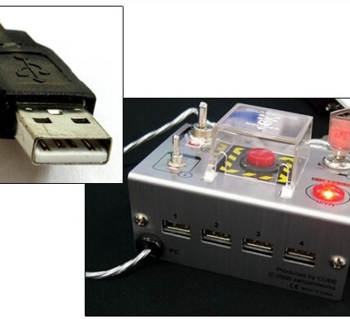
I just needed a USB input plug...

Slide 25
Interface Segregation Principle
No implementation should be forced to have methods that it does not use (or need)
Use multiple, smaller interfaces
Advantages:
Simpler classes, just with needed functionality
No need to implement a lot of unnecesairy methods – e.g. MembershipProvider
More:
https://dotnettutorials.net/lesson/interface-segregation-principle/
https://exceptionnotfound.net/simply-solid-the-single-responsibility-principle/

Slide 26
vehicles Sample
Interface Segregation Principle

Slide 27
Liskov’s Substitution principle

Slide 28

WHO IS Liskov?
Barbara Liskov
https://en.wikipedia.org/wiki/Barbara_Liskov
One of the first women with Stanford PhD
With Jeannette Wing, she developed a particular definition of subtyping, commonly known as the Liskov substitution principle
Currently, she leads the Programming Methodology Group at MIT

Slide 29

Liskov’s Substitution Principle
T
(parent)
If ChildClass is a subtype of ParentClass, then any object of type ParentClass may be replaced with an object of type ChildClass without breaking the program
Signs that this principle is broken:
Return NotImplementedException() in a child method
Child method has empty (not implemented) body
Any child class should be able to do anything the parent can do
Always ask yourself “Is S a T”?
S
(child)

Slide 30
Liskov’s Substitution Principle
Shape
Shape
Rectangle
Square
Rectangle
Square

Slide 31
Square Sample
Liskov Substitution Principle

Slide 32
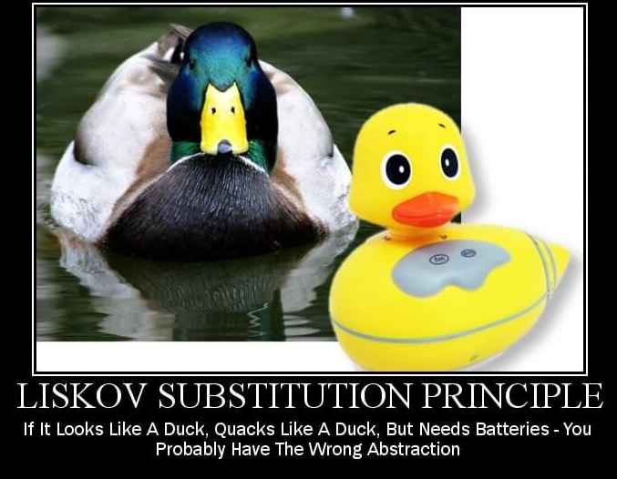
OTHER EXAMPLES – Is “S” a “T”?
Animal
Duck
DuckToy
Image Source: https://exceptionnotfound.net/simply-solid-the-liskov-substitution-principle/

Slide 33
OTHER EXAMPLES – Can an ostrich fly?
a
a
Animal
Animal
Bird
- LayEggs()
Bird
- LayEggs()
- Fly()
FlyableBird
- Fly()
Ostrich
Pigeon
Ostrich
Can it fly?
Pigeon

Slide 34
ARMY Sample
Liskov Substitution Principle + Interface Segregation Principle

Slide 35
Class Hierarchy (begin)
Soldier
ISoldier
Officer
HeadOfState

Slide 36
Class Hierarchy (end)
RegisteredSoldier
Soldier
IRegisteredSoldier
ISoldier
Soldier
HeadOfState
Officer
IReportable
ICommander
HeadOfState
Officer
ICommander

Slide 37
Covariance and contravariance
Covariance | Contravariance
The return type of a method | - Refers to the input type of a method
If you have a return type for a method, that return method should not change | - If you have a input of a type for a method, you should not change that type

Slide 38
Open / Closed principle

Slide 39
Open / Closed Principle
Software entities should be:
Opened for extension = You can add new behviour
Closed for modification = You should not change the source/binary code
Write your code so that you will be able to add new functionality without changing the existing code
Bug fixes are exceptions - you need to change the code

Slide 40
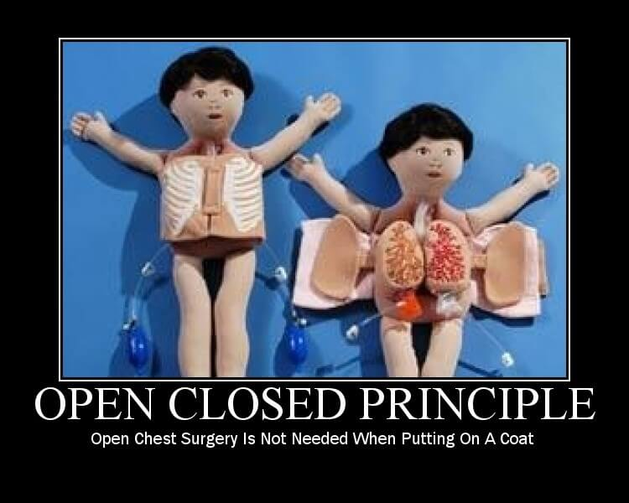
Open/Closed principle
Source: https://www.exceptionnotfound.net/simply-solid-the-open-closed-principle/

Slide 41
MUSEUM Sample
Open/Closed Principle

Slide 42
Why it isn’t Open/Closed?
Museum
Person
_visitors
_FullTicketPrice
IncomeFromTickets
Visit(person)
Name
Age
Decides the ticket price, using multiple if statements

Slide 43
HOW TO APPLY OPEN/CLOSED PRINCIPLE?
Use abstractions:
Interfaces
Abstract clases
Use parameters
What is the price of a full ticket?
Inheritance / „Template Method” Pattern
Create a base class and add a method that will be implemented differently in each child class
Composition / „Strategy” Pattern
The class depends on an abstraction, that plugs in with the actual implementation

Slide 44
Inheritance – „Template MethoD” Pattern
Person
Museum
Name
Age
[abstract] TicketPriceMultiplier {get}
_visitors
_FullTicketPrice
IncomeFromTickets
Visit(person)
Child
Adult
Senior
TicketPriceMultiplier = 0
TicketPriceMultiplier = 1
TicketPriceMultiplier = 0.5
Just multiplies ticket price with the person’s TicketPriceMultiplier

Slide 45
composition – „STRATEGY” Pattern
Museum
Person
ITicketStrategy
_visitors
_FullTicketPrice
IncomeFromTickets
Visit(person)
Name
Age
TicketStrategy
TicketPriceMultiplier {get}
ChildTicketStrategy
AdultTicketStrategy
SeniorTicketStrategy
TicketPriceMultiplier = 0
TicketPriceMultiplier = 1
TicketPriceMultiplier = 0.5
Just multiplies ticket price with the person’s strategy multiplier

Slide 46
TO USE OR NOT TO USE Open/Closed Principle
Advantages:
Less likely to introduce bugs
No need to recompile and deploy code that is already compiled and deployed
Simpler code
Usually uses if / switch cases, making it more difficult to follow and test
Disadvantages:
Abstractions add complexity
Too many classes

